Slide 1
The Running Project
The Turing Eagles - Wes Stafford, Matt Kuhn, Mark Oliverio, Hannah Ringo

Slide 2
Project Aim and Goal
To allow runners to view and keep track of local race times
To allow other users to add race times to the database for viewing by registered runner users
To create a running app which hasn’t been done before

Slide 3
Requirement Analysis
Functional
logging in and related functions
create account
query race results
not whole db, as they shouldn’t be able to query users
submit race results
with proper authorization
Nonfunctional
Windows accessible.
Respond in real time to user queries.
Available whenever hosting server is online and running the server
Notes:
hey guys

Slide 4
Summary of Use Cases
Two admins: one for the database and another to maintain the app after release
Alpha User: Can search for races and runners, view race results, sort the data by date, race name, race type (5k, 10k, etcetera), filter sex, age, etcetera and possibly put up their contact info (probably just email address).
Delta User: can submit and modify race results

Slide 5
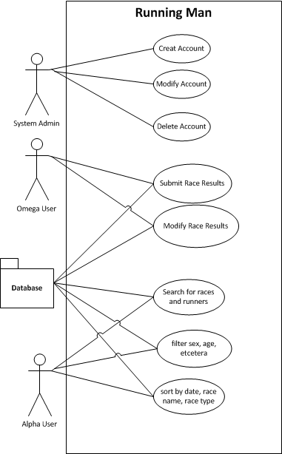
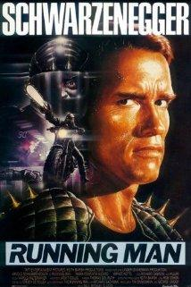
Use Case Diagram

Slide 6
Future Working Plan
Design Database
Keep track of Meeting Minutes
Implement ability for non-user to register an account and thus become a user
Implement ability for app to pull from server
Implement ability of alpha user to view race results
Implement ability of delta user to submit results of races
Implement various other non-essential systems

